Slide 1



RTML: Machine Learning
Rob Lyon
University of Manchester (SKA Group)
@scienceguyrob
robert.lyon@manchester.ac.uk

Slide 2
Goal
I hope to lead you through the fog of misunderstanding surrounding automated decision making!
Disclaimer: Difficult to do well in 30 minutes - some background reading required.
Based on feedback, I’ve assumed zero prior experience.
Notes:
Machine learning is a sub-field of artificial intelligence concerned with replicating the human capacity for learning. As such, machine learning is a topic underpinned by knowledge from multiple fields. These include Neuroscience, logic, statistics, and electrical engineering.
These topics are difficult to cover in 30 minutes! To truly understand machine learning, additional background reading/research is required. I hope to give you a head start today that minimises any reading you’ll need to do. For that reason I’ll cover the basic principles that should require no prior ML experience to understand.

Slide 3
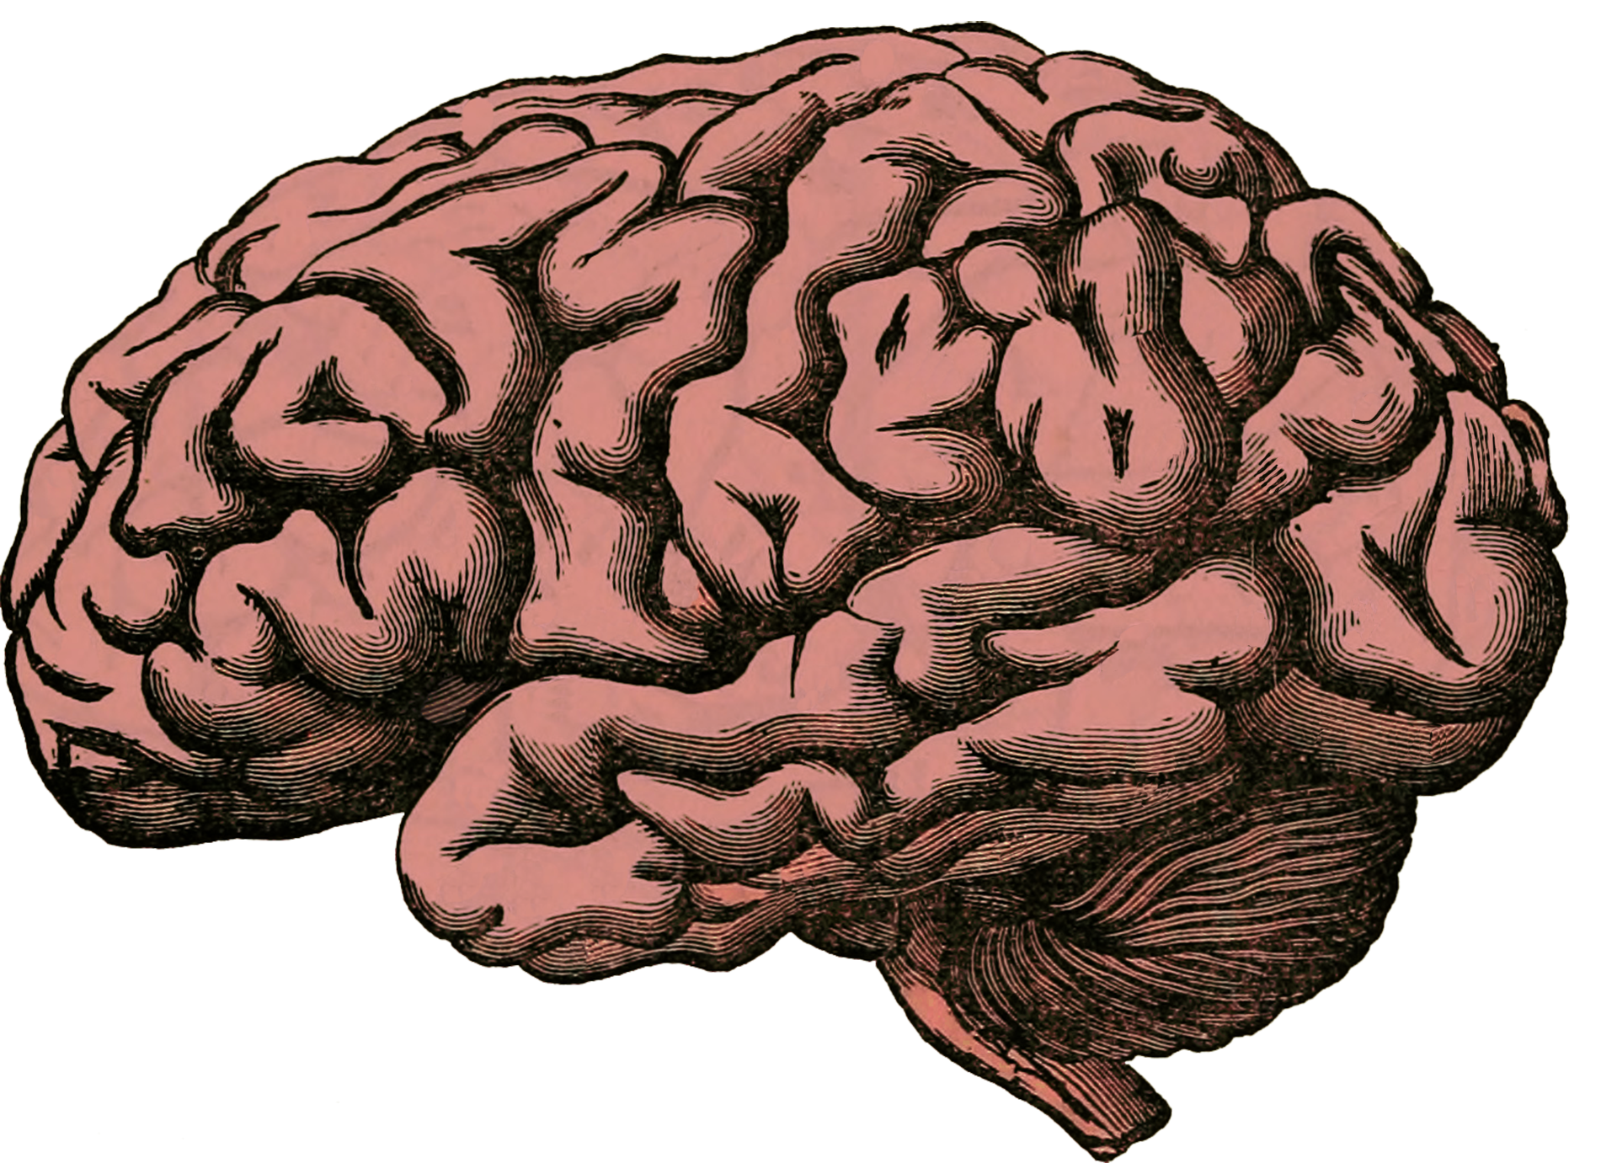
Human Decision Making
Using available information / experience, make optimal decisions.
Actions /Decisions
Data (Sight, sound, taste, touch, smell)
Notes:
Let’s start by thinking about how human decision making works. Humans are capable of sophisticated learning via trial & error, reinforcement, or by receiving information from some form of oracle (parent, teacher, sibling, friend, book etc).
In all cases we can think of the sum of our knowledge and experiences as a dataset E. This dataset becomes populated as our senses (sight, smell, sound etc) start collecting information about the world. When we’re born, this set is mostly empty. But through trial and error we begin to connect experiences/information with some tangible outcome/label. In this model our experiences are data describable by x, and the outcome some form of label y. So for example most babies learn automatically that when x=cry, then y=parental attention.
We can view our learning as we grow through (x,y) pairs. Sometimes the pairs are incomplete. Sometimes we have x, but we don’t know y. For example, the very first time we see x=furry four legged creature, we may not know that y=Cat. After all, y has many possible labels (dog, horse, etc). But we’re capable of learning the correct value for y from some teacher, or by inferring y on our own given previous experience.
We note that in this way, everyones experience differs. Thus no two experience sets are the same. Instead my experiences are E1, your E2 etc…

Slide 4
Human Decision Making
Humans capable of accurately,
Clustering
Classifying
Prediction
Inferring
Made possible via a feedback cycle.
Feedback
Notes:
Given this experience set, humans are capable of extremely sophisticated learning. For example:
Given a few examples of different types of animal, we are able to group them together (clustering) in different ways.
Similarly we are able to classify them as different types of animal too (e.g. mammal vs. bird).
We can make predictions based on our past experiences, i.e. it’s unlikely to rain when it’s sunny out.
We can also infer new knowledge - if it’s sunny and therefore unlikely to rain, people are likely to enjoy the pleasant weather.
Such sophisticated learning is only possible due to the feedback we receive during our lives. If this feedback is inaccurate, or poor quality, so too will be our decision making. This seems obvious to say, but a good education (i.e. receiving high quality feedback) generally makes individuals better decision makers.

Slide 5
Human Decision Making
Features
Labels ( Feedback )
Humans innately good feature extractors!!
Notes:
Lets think about what our experiences - the (x,y) pairs; actually look like. As humans we are able to use our senses to extract key features we can use to make decisions. So for instance when we look at an animal, we can almost automatically assess it’s size, mass, age, species, etc. These characteristics/attributes are known in the machine learning field as features. Humans are insanely good feature extractors. We do this almost innately. Humans can use features to filer through their past experiences to make decisions.
For instance, suppose via sight we observe an animal with the following features x={four legs, fur coat, golden coloured fur, two eyes, medium size}.
We search our past experiences which cover all the animals we’ve seen, and we use that experience to determine some suitable labels. These might include y={animal, mammal, canine, dog, Golden Retriever}. If someone has never seen a Golden Retriever before, then perhaps they would be unable to assign that label. But they’ll probably still be able to tell you that the animal is a mammal, a canine and a dog - that’s the wondrous thing about human intelligence and decision making. However it’s not perfect….

Slide 6


Our Focus: Classification via Functions
Mammals
Mammals
Birds
Birds
Notes:
Lets just focus on classification for now. This is a process that assigns classification labels to unknown items/objects, using past experience to guide the process.
Humans do this well, we can easily group and classify as previously described. There are many different types of learning:
Learning via reinforcement
Learning via trial and error
Leanring via a teacher
Learning by yourself…

Slide 7

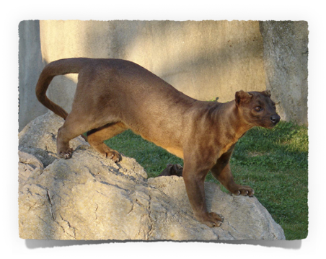
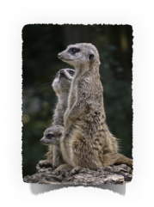
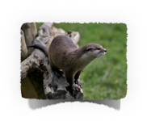

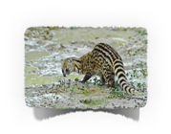
Human Decision Making
By Ran Kirlian - Own work, CC BY-SA 4.0, https://commons.wikimedia.org/w/index.php?curid=4164754
Notes:
Lets test your own decision making - Can you tell me which family of creatures this animal is most closely related to? This will only work if you haven’t seen it before….
Is it,
Canine?
Feline?
Lutrinae (Weasel, Otter, Bandger relative)?
Viverridae (e.g. like a Civit, lower right picture on the slide)?
Marsupial?
Mongoose (e.g. Meerkats)?
I can imagine your currently searching you past experience, and looking for features that you hope will tell you what type of animal it is!
For the answer, scroll down!
This animal is a Fossa, endemic to Madagascar. It’s most closely related to the Mongoose family, though appears very similar to felines in most respects. This is thanks to the process of convergent evolution. If you answered correctly, then your past experiences were sufficient for this classification task. If not, then your experience was lacking - but now you’ve learned via trial and error, so you’re unlikely to make this mistake again.

Slide 8
Making Optimal Decisions?
Many have tried to understand how to make optimal decisions.
We know we *should* use available evidence at all times.
We are fundamentally bad at this - we regularly make bad decisions.
We are biased decision makers - we often use instinct and personal experience to decide.
Available
Knowledge &
Experience
Personal
Knowledge &
Experience
Knowledge used
To make a decision
Set of all knowledge
on subject A
Notes:
Given this way of thinking about decision making, we know we must make decisions using all available information. But humans are actually quite bad at doing this. We’re biased decision makers.

Slide 9
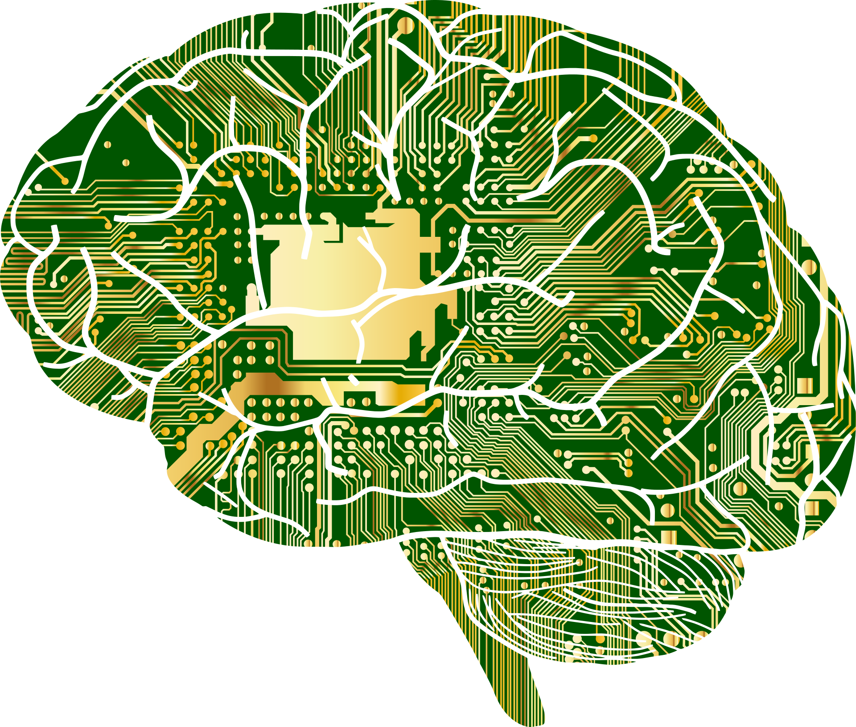
Automated Decision Making
Machine Learning is concerned with making optimal decisions using the tools of statistics.
Decisions /Predictions
Data (variables, measures, expected outcomes, actual outcomes…)
Feedback
Notes:
So what about the artificial analogues - surely they’re not susceptible to the same mistakes as humans…. Well actually they are. But first, let’s frame the artificial analogue for human decision making.
Artificial systems make decisions based on values taken from sensors (e.g. camera, microphone etc) or data from other computational/record systems that keep track of information. Much like in humans, where experiences are associated with outcomes, the same holds true in artificial systems. Input data x, is associated with some outcome\label y. For instance, consider a simple automated thermostat. Here x is the temperature measured, and y is the outcome that should be fed to a heating system (if too cold, then instruct the heating system to turn on!).

Slide 10
Automated Decision Making: Terminology
Experience is known as training data.
An algorithm is ‘taught’ using training data.
Training data can be labelled or unlabelled.
We evaluate performance on a disjoint dataset called test data - this data must be labelled (ground truth known).
If classifying or categorising data, the ground truth is known as a ‘true class label’.
Labels
Training
Data
Notes:
Important to introduce some basic terms before we go on.

Slide 11

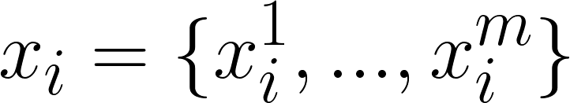
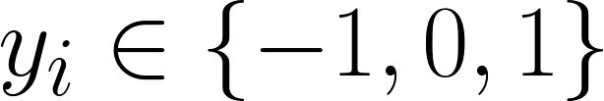
Automated Decision Making
Features
Height
Mass
Age
Labels ( Feedback )
e.g. -1 = positive/disease …etc
Most Automated methods are basic feature extractors (if at all)!!
Notes:
Whilst humans can automatically extract sophisticated features to make decisions, our artificial analogues are much less capable.
Generally, we must extract features for them. So whilst a human can look at an animal and automatically assess it’s mass (approximately), we must give the artificial system the mass value directly. But how is this information used?
In humans, you can scan your experience and consider examples of animals with similar masses, to an unknown animal currently in front of you.
Artificial systems instead compare the mass value against a numerical distribution (stored in E) describing the mass values for all the animals previously observed. It can then connect the distributional information to the labelled feedback at it’s disposal - I.e. choose a label appropriate for an animal of this mass.

Slide 12
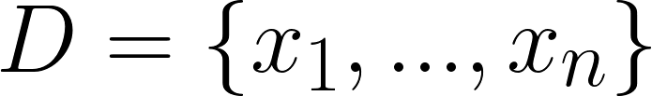
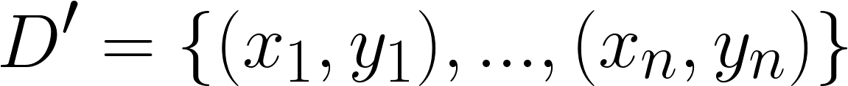
Our Focus: Classification via Functions
Features
Extract
Extract
Features
Mammals
Labels
Predict
Mammals
Birds
Birds
Notes:
Here we see this scenario summarised. Data from the real-world is fed to an artificial system via feature vectors. If the ground truth is known (i.e. we know the labels for the animals) then this is called a labelled feature vector X={(x1,y1),…,(xn,yn)}. The labelled feature vector is used to “teach” an automated system about the animals described in the feature vector.
Then we obtain a new set of animals for which we have no labels. As before, the real-world animals are described via features but this time as an unlabelled feature vector. We then ask the artificial system to predict labels for these examples - hopefully it accurately categorises them.

Slide 13
Making Optimal Decisions?
Algorithms may have access to more quantifiable data than humans.
However the data may be biased/incomplete.
Individual algorithms also have intrinsic biases.
Algorithms can therefore just as fallible as humans!
Available
Knowledge &
Experience
Knowledge / Experience
captured by algorithm
Knowledge used
To make a decision
Set of all knowledge
on subject A
Notes:
Given this way of thinking about decision making, artificial systems are clearly capable of making decisions using all available information. This works well, so long as that information is complete and representative. However remember that just like people, artificial systems also have intrinsic biases too. So artificial decision making systems are similar to us in more ways than we realise.

Slide 14
But how is automated learning done?
Decisions /Predictions
Data (variables, measures, expected outcomes, actual outcomes…)
Notes:
It’s hard to explain how humans beings actually learn - but we can explain how artificial systems learn. We’ll try and do that now. So far we’ve established that these systems learn from data expressed in pairs - a labelled feature vector.

Slide 15
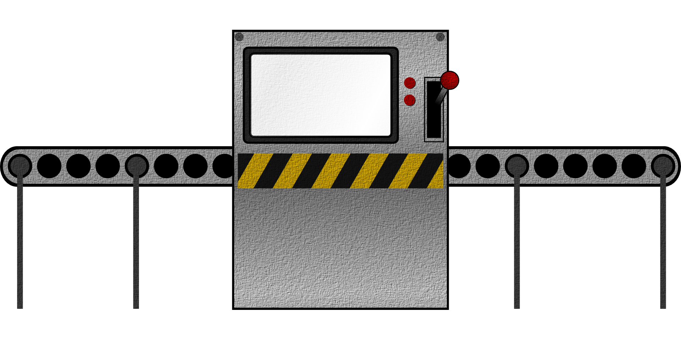
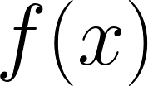
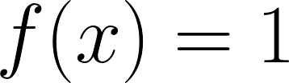
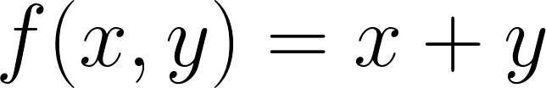
Our Tools: Functions and Parameters
Functions are simple input/output boxes.
Machine learning algorithms are functions that ingest data, and produce some output.
How they do this is hard to convey without some basic mathematics!
Parameters
Outputs
Notes:
Automated decision making is done upon the labelled feature vector using mathematical functions. A function can simply be thought of as an input-output box. Some data enters (features + labels), and predictions are produced as outputs. Functions come in all shapes and sizes, and are controlled by parameters. Machine learning is fundamentally concerned with building functions that produce minimal error rates by choosing the optimum set of parameters.

Slide 16
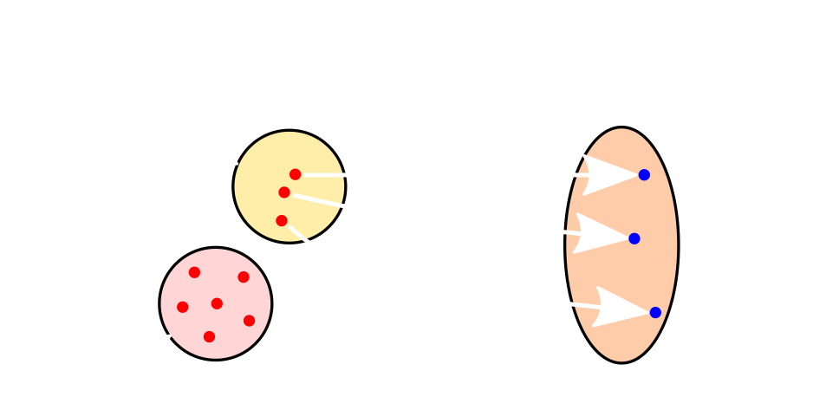
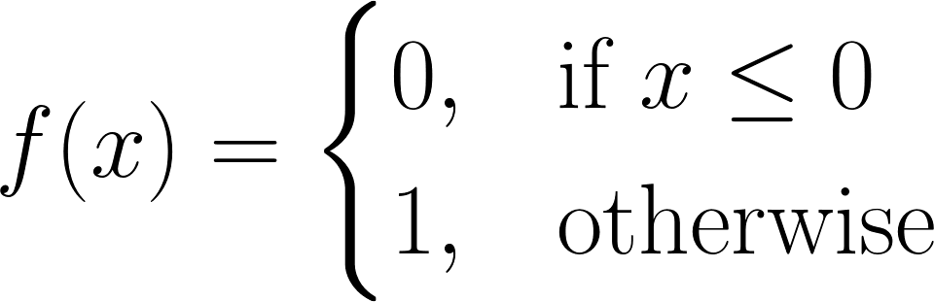

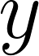
Our Focus: Classification via Functions
E.g.
Observations
New data
unknown mapping
x¹ | x²
7.4 | 29
6.6 | 24
3.1 | 11
… | …
0.5 | 2
y¹
Diabetic
Diabetic
Non-diabetic
…
Unknown
Notes:
It’s hard to convey how functions do this without a simply example. Perhaps the most simple decision making function is the “decision stump”. The stump partitions a data set into two groups, labelling one group as 0 , and the other group as 1. This is achieved via a simple threshold over a chosen feature variable. The threshold is a configurable parameter, and we can choose a threshold that yields the lowest error rate. Or to be more exact, use an algorithmic procedure to search for the optimal threshold value that minimises the error rate.
Consider a simple example - lets suppose we want to categorise adults and children according to body mass in KG. Humans come in all shapes and size, and develop at different rates. Thus some children have greater mass than adults, though on average adults have more mass than children. A decision stump will split on the optimal mass in KG, such that examples less than the threshold are categorised as children, and if greater than (or equal to ) the threshold categorise them as adults. You’ve now encountered your first trivial classifier.
The example in the slide shows a similarly example, this time for blood sugar levels. There should be some level of blood sugar concentration indicating that a patient is diabetic. The key is to find that blood sugar level in order to make good predictions.

Slide 17
What function/s to use for mapping?
Classification algorithms come in all shapes and sizes.
Inside their comprised of functions, which attempt to perform the mapping from to in different ways.
What they have in common:
All are evaluated against some feedback metric, which guides their learning - call this the error rate.
They must choose (find) parameter values that minimise the error rate.
Notes:
There are many ways to solve problems, and many ways to learn. Unsurprisingly then there are many types of learning algorithm available. Often inspired by the way humans learn to solve real-world problems.
All these artificial methods have one thing in common - they learn by trying to minimise error rates on the data they learn from.

Slide 18
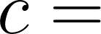
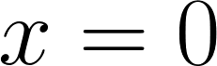
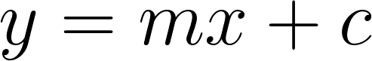
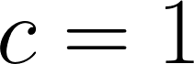

Error as Feedback - Example:
Value of when
We often need to find a line that fits the data to make predictions.
E.g. house prices, blood sugar levels etc.
Usually we apply tools such as least squares regression.
Aim to minimise the sum of squares between the residuals (a residual being: the difference between an observed value, and the fitted value provided by a model).
Notes:
Here I present a simple example of how minimising error can lead to the illusion of learning. Suppose you want to sell your house, but are unsure of the optimal price. As a good scientist, you collect data on houses sold in your area according to their size in square metres, and you produce a scatter graph. Clearly larger houses sell for more - but what price should you try to sell for?
Normally we fit a line of best fit to the data, and use that to make predictions. The line of best fit is describable by the well known equation of a line, y = mx + c. But which parameters give us a line which yields the most accurate predictions? Well, we use an optimisation procedure called least squares regression, to find the line that minimises the sum of differences from the scatter points to the line. Here we’re treating a larger sum of squares as indicative of higher error.

Slide 19
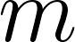
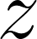
Feedback via Error minimisation
Simple optimisation problem here. Choose a value for that minimises the residuals for .
We can think of the summed residuals as an error rate, .
Sum of squared
Differences
(error)
Notes:
The search for the parameters that yield the lowest sum of squares, is more commonly known as a minimisation problem. In this case, an error minimisation task.
So in this way we can use a mathematical optimisation procedure to find a line that fits the data well - this line will make good predictions. No real learning has happened, but we have created a model that can make accurate predictions - just as good as someone learning the data and making a prediction using their experience.

Slide 20
Machine ‘Learning’ in name only…
This isn’t really learning right?
It’s a search for parameters that minimise some error rate.
Learning effectively reduced to a parameter search!!
Minimise mapping error using:
Given these
Predict for these
And some function:
Notes:
But nothing has really ben learned - we’ve simply optimised some error rate produced by a function.
Welcome to machine learning - that’s basically what it’s all about. If you do it well, it gives an illusion of intelligence, but it’s just optimisation/searching!!

Slide 21
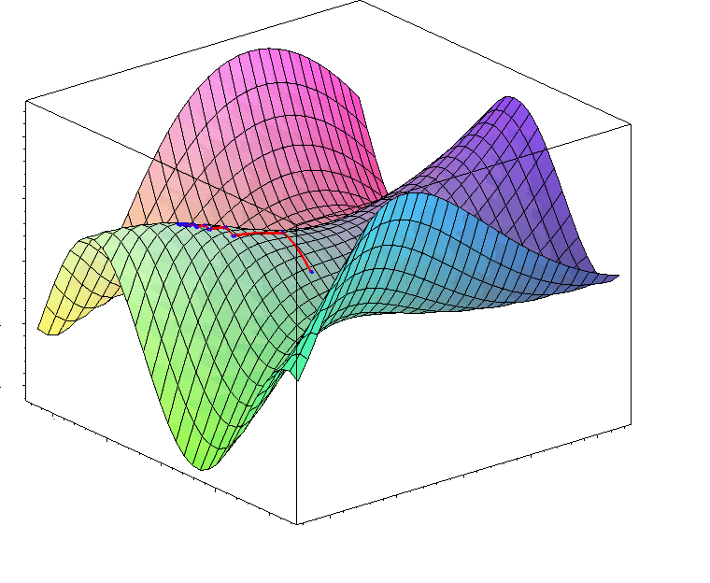
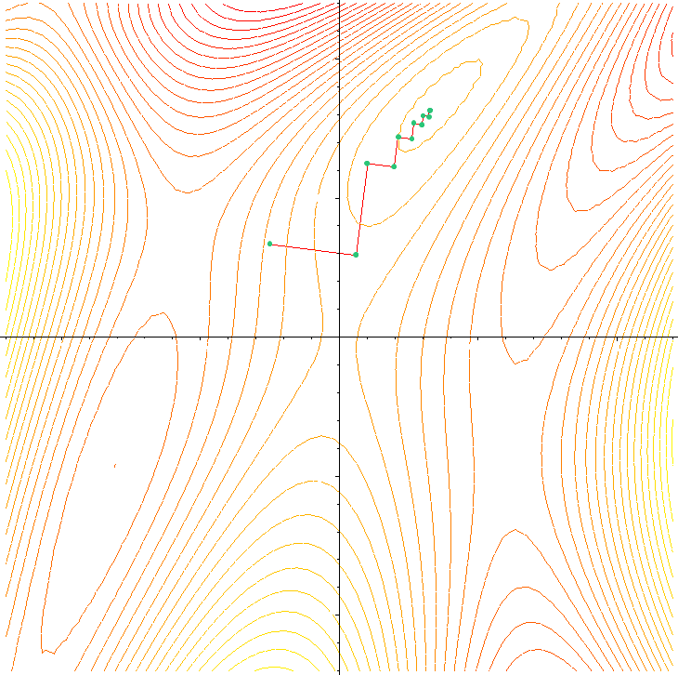
Maximisation / Minimisation.
At a fundamental level ML algorithms are mathematical functions concerned with minimisation or maximisation.
Given this data, with these labels, minimise the error on new data…
Notes:
It is important to understand how maximisation/minimisation problems are understood in terms of an optimisation landscape. This landscape shows how different parameter values produce different outputs in an easy to understand 3-d visual representation.
Some parameters yield minimum or smaller output values, which manifest as valleys in the landscape. Those parameters yielding maximum or higher output values manifest as mountains or peaks.
If the output variable is error, then it is desirable to find the parameters that yield the minimal error - the lowest point in the landscape. Clearly we can see this by eye, but we must use mathematical algorithms that must search for this minimum for us.
If there are many parameters, this search can be very computationally expensive. It usually means we can’t test all different parameter combinations to find the minimal output value. We instead have to use search techniques that try and find those parameters. Those methods aren’t perfect. Sometime they can be fooled into thinking they’e find a minimum value, when in reality they’ve only found a sub-optimal local (not global) minima. The same applies for maxima.
It is important to understand that ML algorithms attempt to minimise their error rates by finding the parameters that produce the global minimal error rate. When they don’t find it, they are sub-optimal, perhaps not working quite as we’d like in practice.

Slide 22
Maximisation / Minimisation.
ML algorithms ‘learn’ by searching for parameters that maximise or minimise error/loss on data we give them.
Such problems are usually non-trivial with complex ‘landscapes’.
Lot’s of sub-optimal maxima and minima in those landscapes.
Shaped by the features we provide our algorithms.
Often no perfect way to find exact answer (in reasonable time).
Notes:
This slide just builds on the details from the previous slide. This wikipedia page may help understand the content: https://en.wikipedia.org/wiki/Mathematical_optimization

Slide 23
Back to the key point….
ML reduces learning, to choosing an optimal set of parameters that result in the greatest reduction in the observed error rate.
Whilst this applies across the board, ML algorithms can be significantly different in how they,
View such problems.
Solve such problems

Slide 24
Types of classifier
Generative
Discriminative
Supervised
Learning
Semi-supervised
Learning
Supervised
Learning
Semi-supervised
Learning
Unsupervised
Learning
Unsupervised
Learning
Notes:
Supervised Learning - this is the standard student teacher model. You provide an algorithm with a training set with labels. It learns from that data, and tries to make new predictions.
Semi-supervised Learning - similar to the student teacher model. We provide a training set which has some labelled examples, and some unlabelled examples (true class unknown). The algorithm tries to learn from both the labelled and unlabelled training data to label examples. Think of this as trying to teach a child to tell cats from dogs. You prove them with a dataset for which only the pictures of cats have their true class labels. A human child can infer that the other animals must be dogs (humans are amazing!). Algorithms try to do the same, but with less success in practice!!
Unsupervised learning - the training dataset contains no true class labels. The algorithm must learn to categorise/group the data based purely on their characteristics. The assumption here - there must be some underlying structure to the data.

Slide 25
Types of classifier
Unsupervised
Learning
Supervised
Learning
Semi-supervised
Learning
Mammals
Mammals
Birds
Notes:
This slide simply expands the details of the previous slide.

Slide 26
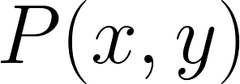
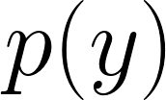
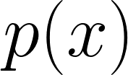
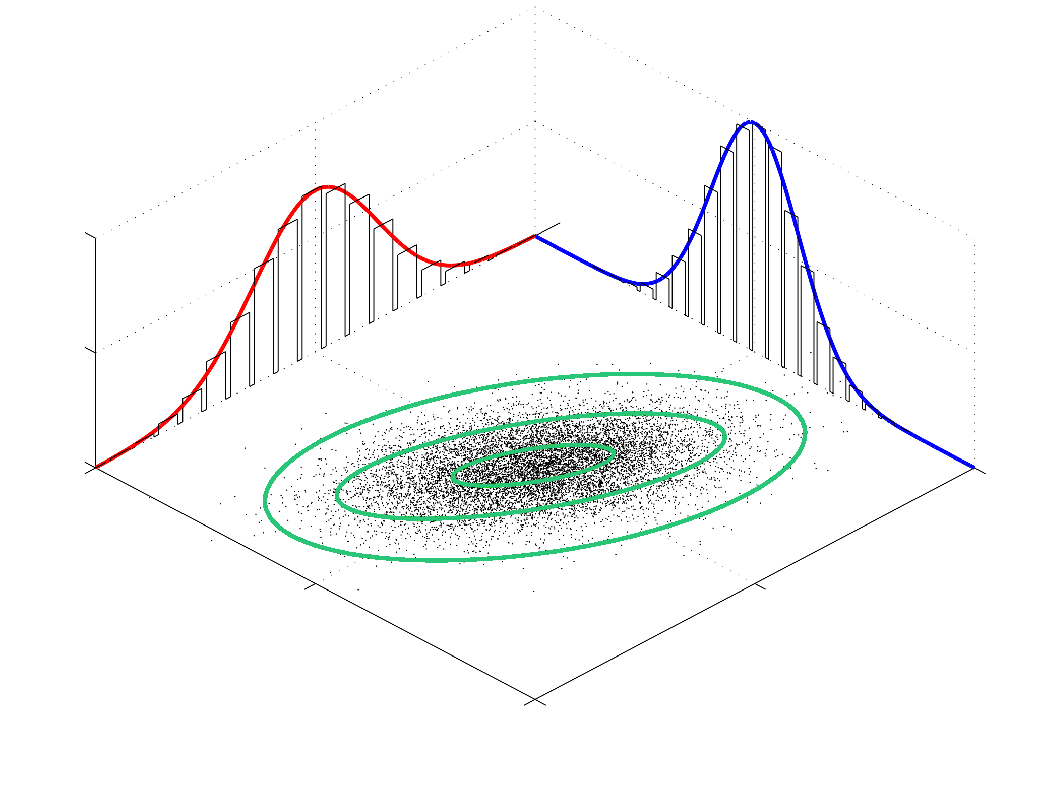
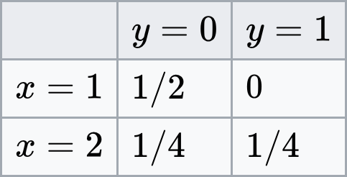
Generative Model
Makes strong assumptions based upon data distributions
Relies on the data being suitable and correct.
Joint Probability
Notes:
Please see https://en.wikipedia.org/wiki/Generative_model for more information.

Slide 27
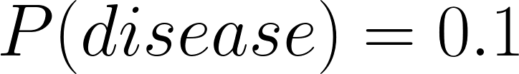
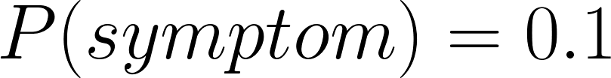
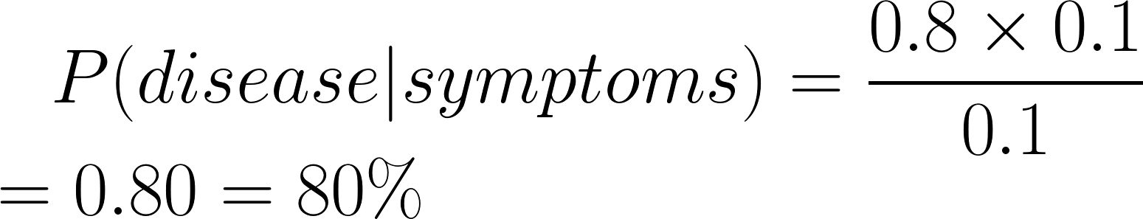
Generative Decision Making
Bayes’ Theorem
Here the optimal decision involves choosing the hypothesis with most likely outcome!
Notes:
Consider a binary classifier trained to detect the presence of a specific disease in patients aged between 1-10. The prevalence of the disease in this group of patients, is given by the prior probability (The prior probability can be read as the probability of P(X) occurring. Suppose this prior is P(disease)=0.1 which corresponds to 10%. Suppose that there is some symptom associated with the disease, such that the likelihood of having the symptom, if afflicted with the disease, is P(symptom|disease)=0.8. This indicates that 80% of the time, patients with the disease exhibit the symptom. Finally suppose the marginal likelihood of having the symptoms in general is P(symptom)=0.1. A Bayes optimal classifier can use Bayes theorem to predict the posterior probability of having the disease given the symptom.

Slide 28
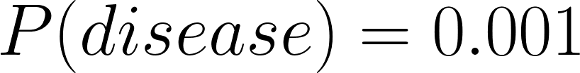
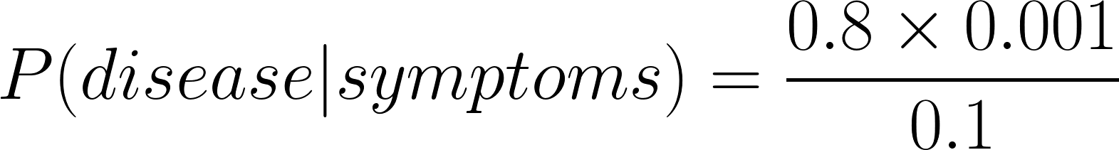
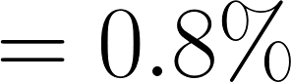
Generative Decision Making
1 to 10 year olds
40 to 60 year olds
That’s our first ML algorithm - Naive Bayes.
Notes:
We can see here that by updating the prior P(disease), we get a very different estimate for the likelihood of the disease. This illustrates an important point - generative learning can work well, so long as the probability estimates underpinning them are reliable. If the data is not reliable, or incomplete, it’s hard to trust the predictions.

Slide 29
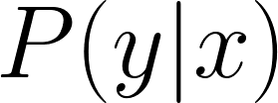
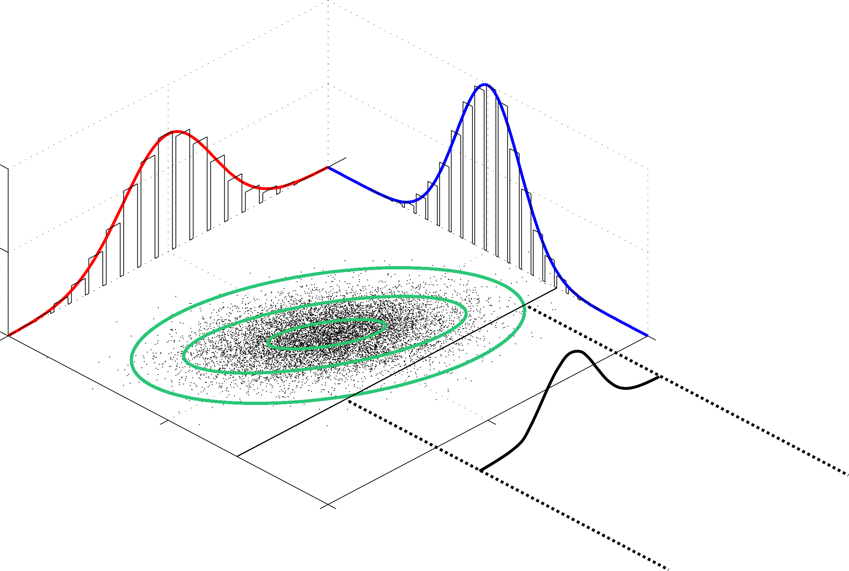
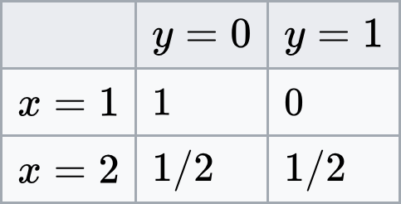
Discriminative models
Conditional Probability
Based on observed outcomes, as opposed to probability distributions.
Notes:
Please see https://en.wikipedia.org/wiki/Discriminative_model for more detail.

Slide 30
Generative vs. Discriminative Models
Fundamental approaches to decision making in ML.
Both have strengths and weaknesses in different scenarios.
Generative models essential model how the data was generated.
Discriminative models don’t care how the data was generated, but learn to accurately categorise based on what it’s observed.
“On Discriminative vs. Generative classifiers: A comparison of logistic regression and naive Bayes”,
Andrew Y. Ng,
Michael I. Jordan
Notes:
I can’t say that one group of methods always works better than another. That’s simply not true. However it is true that in certain circumstances, some methods do produce better results. The paper referenced here by Ng and Jordan considers this, and makes some recommendations.

Slide 31
Tree Learning - Discriminative
4.
2.
3.
1.
6.
1/1
4/4
5.
Notes:
https://en.wikipedia.org/wiki/Decision_tree_learning

Slide 32
Tree Learning - Discriminative
4.
2.
3.
1.
6.
1/1
4/4
5.
Which feature to split on, if each example has many features?
What feature value to split on?

Slide 33
Tree Learning - Discriminative
At each spilt point, find the feature that maximises the separation between each class.
Done by considering the statistical distribution of the features.
Via an optimisation method (search over the possible split-points, find the best), choose a split-point threshold that allows a split on that feature.
1/1
4/4

Slide 34
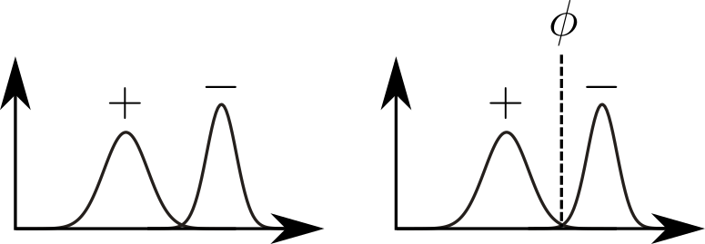
Tree Learning - Discriminative
Threshold with max separability
Density
Value
1/1
4/4
Errors
Threshold Value

Slide 35
Random Forest - Discriminative
Combines many trees - but randomly chooses splits.
Aggregates predictions over many trees.
Helps as trees generally make “greedy” decisions.
Notes:
https://en.wikipedia.org/wiki/Random_forest
Also consider reading more about ensemble methods: https://en.wikipedia.org/wiki/Ensemble_learning

Slide 36
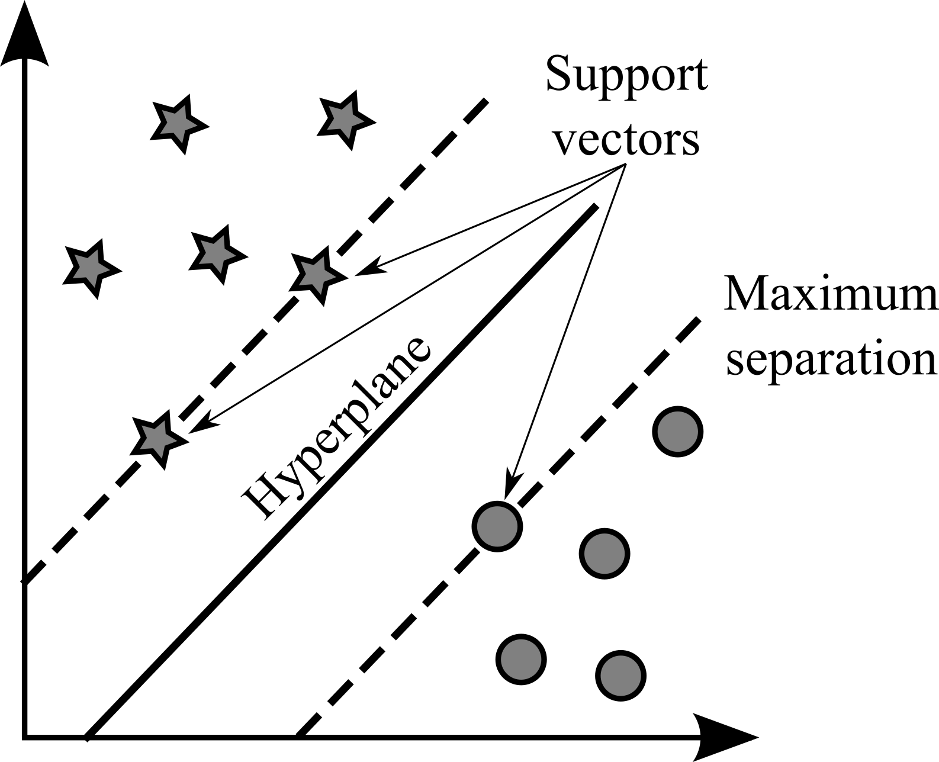
SVM - Discriminative
Goal is to find a maximally separable margin between the classes.
Notes:
https://en.wikipedia.org/wiki/Support-vector_machine

Slide 37
KNN
(1,1)
e.g. in Euclidean space
(0,0)
k=7
k=5
k=3
?
k | Prediction
3
5
7
Notes:
https://en.wikipedia.org/wiki/K-nearest_neighbors_algorithm

Slide 38
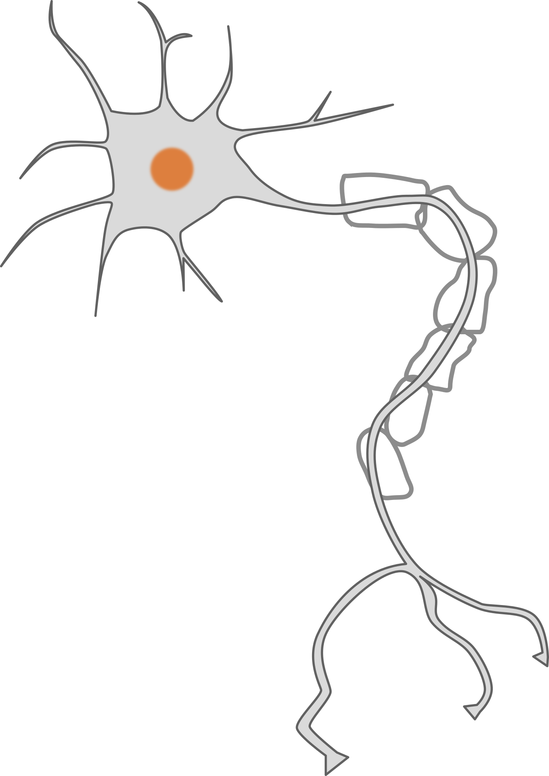
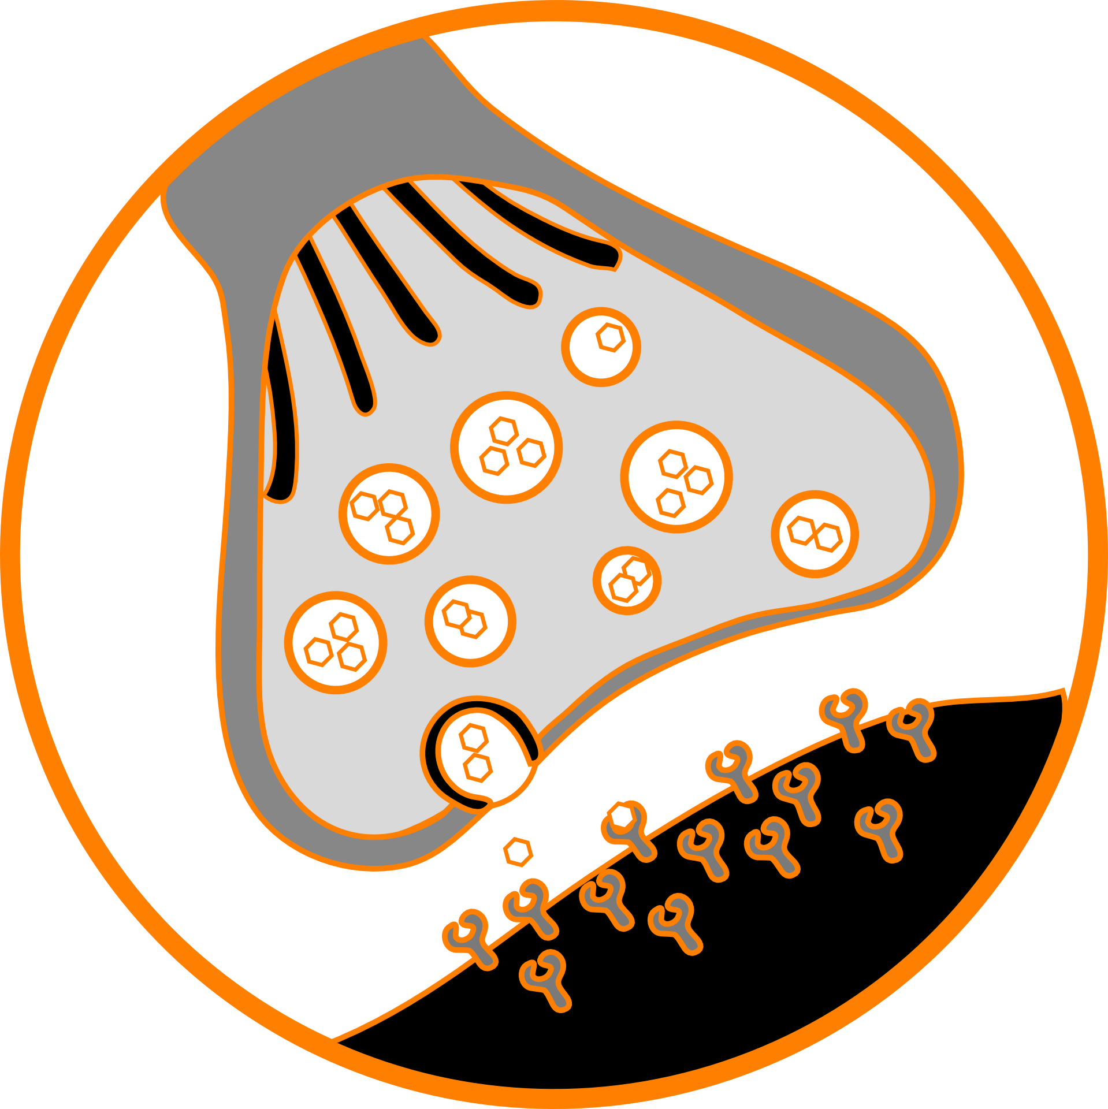
Biological Neuron
Dendrite
Nucleus
Axon
Synapse
Axon Terminal
Notes:
Now, for some neuroscience. In the human brains, trillions of interconnected neutrons propagate electrical signals that allow us to learn, store/access memories, and navigate our world.
Individual neurons are able to “fire”, which involves propagating an electrical impulse from the dendrites to the axon terminals, if it is sufficiently stimulated. That is, if a neuron receives electrical impulses from one or more nearby neurons, this may cause it to fire. The electrical impulse is passed to other nearby neurons via the synapse. This is a region filled with a conduction neurotransmitter that assists the transmission of electrical impulses.

Slide 39
Biological Input/Output Machines
Electrical Impulses
Electrical Impulses / No impulses
Learns given feedback
Notes:
In this way, the biological neuron can be thought of as an input/output box. It receives electrical impulses as input, and can produce electrical impulses as output.

Slide 40
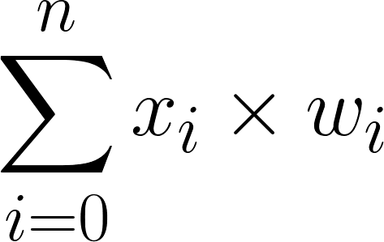
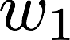

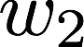
Artificial Neural Net (1)
Training data
0 | 0 | 0
0 | 1 | 0
1 | 0 | 0
1 | 1 | 1
?
Logical “AND”
2
Example:
 |  |  |  |  | Output
Test 1 | 1 | 1 | 0 | 1 | 0
Test 2 | 1 | 1 | 1 | 1 | 1
(1 x 1)+(1 x 0) = 1 (Not firing)
(1 x 1)+(1 x 1) = 1 (Firing)
Notes:
The artificial analogue of the biological neuron was first conceived in the early 1940s (see https://en.wikipedia.org/wiki/Artificial_neuron#History). I present an example of a simple artificial neuron above. This example actually models a simple logical truth, in this case Logical “AND” (see https://en.wikipedia.org/wiki/Logical_conjunction). For those not familiar with logic or logic gates, think of “AND” as Input/output box with two inputs and one output. The “AND” machine only has two possible output values, 0 or 1. It produces 1 when it’s two inputs (x1 and x2) equal 1. Otherwise it returns 0.
This simple neuron models “AND” via a simple threshold activation function. That is, when the summed input to the neuron is greater than 2, the neuron will “fire” which means return 1. The formula for the sum is also shown. This is actually a weight sum. That means that each of the inputs to the neuron is weighted, in this case by the weights w1 and w2. The table shows how the weights and input values are combined. Remember this neuron only fires when the sum of the weighted input is 2 or greater.

Slide 41
Artificial Neural Net (1)
?
2
Learns by searching for weights and thresholds that reduce the error rate.
Notes:
In the previous slide I’ve simply shown you how to solve “AND” with a simple artificial neuron. In reality, we wouldn’t known the appropriate weights and threshold values required to solve the problem in advance (especially not for sophisticated problems anyway!). Normally we have to search for the appropriate threshold\weights, over some reasonable range. We could search for a threshold over the range 0-100 or -100 to +100. Whatever the range may be, the neuron “learns” the desired pattern by searching for an appropriate threshold, just like other machine learning algorithms search for parameters. Remember, the threshold is a parameter.
Important point here. The artificial neuron has learned “AND” by optimising a set of connection weights and input parameters.

Slide 42
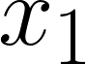
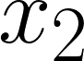
Artificial Neural Net (1)
1
0
1
“AND” solved with a Basic Linear separator
Notes:
We note that the neuron we’ve discussed so far, is actually a simple linear separator. This is demonstrated in the graph at the top right. This shows the outputs for all possible input values (blue =1, red =0). It only fires when both x1 and x2 equal 1. Thus we can see that the outputs can be separated by a simple line, which this neuron is doing correctly.

Slide 43
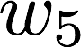
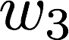


Artificial Neural Net (2)
1
Training data
0
0
1
-2
0 | 0 | 0
0 | 1 | 1
1 | 0 | 1
1 | 1 | 0
1
Logical “XOR”
3
2
Uses Heaviside activation function
Bias term
-1
Notes:
Some problems are more sophisticated - consider the Exclusive Or (XOR) logical operation (more detail here: https://en.wikipedia.org/wiki/Exclusive_or). This only returns 1 when either of the inputs are 1 - but not when they’re both 1 or both 0.
This problem can’t be solved using a linear separator as shown in the top right. To solve it requires extra neurons and more weights, to enable non-linear separation.
The message here is that artificial neural networks, comprised of many many individual artificial neurons, can solve extremely complex problems. The more complex the problem, the more neurons needed.
It is also important to recognise that this small network has recognised the XOR pattern. Once again the artificial neuron has learned “XOR” by optimising a set of connection weights and input parameters. This is how neural networks learn - they find connection weights and threshold parameters that allow them to recognise patterns of arbitrary complexity.

Slide 44










Artificial Neural Net (3)
= (1 * 1 ) + ( 1 * 0)
= 1
Neuron fires
0
-2
= (3 * 1 ) + ( -2 * 0) - 2
= 3 + 0 - 2 = 1
= Neuron fires
= (1 * 1 ) + ( 1 * 0) - 1
-1
= 1-1 = 0
Does not fire
Notes:
This slide shows how the network learns XOR. I only include this information so you can understand whats going on. You should be able to see why the network outputs 1, and when/why it outputs 0.

Slide 45


More Complex Networks
1
0
1
1
0
1
Capable of solving arbitrarily complex functions.
Notes:
To solve arbitrarily complex pattern recognition challenges, ML experts create larger and more interconnected neural networks. These networks get very large, meaning the problem of learning requires the search and optimisation of millions (or more) connection weights, and threshold parameters. It’s actually more complicated them that, but to learn more check out this page (https://en.wikipedia.org/wiki/Multilayer_perceptron). The main thrust is this:
Given a set of input patterns, an artificial neural network learns to recognise them, by attuning connection weights and various parameters. When the network makes a mistake, the connection weights and parameters are updated.

Slide 46



“Deep” Neural Networks
Inputs
Convolution
Pooling
Training / Predictions
Notes:
See this excellent website for more details: https://ujjwalkarn.me/2016/08/11/intuitive-explanation-convnets/

Slide 47

“Deep” Neural Networks
Credit: @goodfellow_ian
2014
2015
2016
2017
2018
https://arxiv.org/pdf/1812.04948.pdf
Notes:
See this excellent website for more details: https://www.lyrn.ai/2018/12/26/a-style-based-generator-architecture-for-generative-adversarial-networks/

Slide 48

“Deep” Neural Networks
Credit: Nvidia

Slide 49

Decision Boundaries
Notes:
So far we’ve talked about a few different machine learning classifiers. There are literally thousands to choose from, each suitable for some specific problem. What I aim to show here is a visual representation of the decisions boundaries they produce. This shows that some classifiers work that work well for datasets with certain spatial patterns, don’t necessarily work well for others. This is known more generally as the “no free lunch” theorem. It essentially tells us that we can’t know which algorithm will work best for our specific problem in advance. We must test a variety and determine for ourselves which works best on our sort of data.

Slide 50



Evaluation
+ = items relevant
- = items retrieved
Irrelevant items
not retrieved (TN)
+
-
Many, many more metrics!
Relevant items
not retrieved (FN)
Irrelevant items
retrieved (FP)
Relevant items
retrieved (TP)
Notes:
Testing for ourselves means evaluating. In machine learning we use standard metrics to evaluate our algorithms. Accuracy is the most easily understood metric, and is sometimes a good indicator of performance. But there are many more metrics. Here I simply introduce the three most common, along with a visual explanation for how their derived.

Slide 51
Over/under fitting
New unseen data:
Good performance
Training data
New unseen data:
Poor performance
Data describing
Test data
Notes:
Over/under-fitting is a big problem for us in ML. Think of it this way:
Under-fitting occurs when a student inadequately prepares for an exam. They learn some of the material, but not in any great depth. They therefore make mistakes, and get a low grade.
Over-fitting occurs when the students over prepares. They learn every word of a text book, and can parrot it verbatim. However if the questions from the exam don’t appear in the text book, they’re in big trouble. Again, the student gets a low grade.
Ideally we want a happy medium between the two.

Slide 52





Over/under fitting
Happens when we optimise too much on training/test data.
Optimal “Generalisation”
Test Data
Real-world Data
Under-fit
Over-fit
Notes:
Here are some further visual examples that depict over/under-fitting in classification problems.
So how to solve this issue? We have to ensure we evaluate our classification methods in the right way. We have to use independent testing/training sets. We have to ensure they data we use to teach our algorithms, is representative of the data it will face when operating in the real-world.
https://en.wikipedia.org/wiki/Overfitting
https://en.wikipedia.org/wiki/Overfitting#Underfitting

Slide 53
Process Phases (1)
Re-design
Features
Example | x¹ | x²
1 | 7.4 | 29
2 | 6.6 | 24
3 | 3.1 | 11
… | … | …
n | 0.5 | 2
Training
Validation
Test Data
Collect Data
Design / Extract
Evaluate
Notes:
Let’s summarise the main phases involved in the application of machine learning.
First we collect our data. This step may involve sub-steps. These can include data normalisation, data cleaning, data labelling, removing personal details according to ethics requirements. Whatever the exact steps are, we should end up with a dataset ready for learning. There should be enough samples in the data set to enable it to be split into disjoint training, test, and validation samples. The data should be representative of the concepts we’re trying to learn, and we should aim to minimise the potential for bias where possible.
The next step involves feature design and extraction. This involves taking the data we’ve collected, and designing some features that we can take from the data, that we believe will help us achieve accurate classifications. So if given a dataset of animal pictures, we can extract many possible features, e.g. has legs, number of legs, number of eyes, colour, size etc. If I now tell you that all the animals in the dataset are four legged mammals, and the goal is to categorise four legged mammals; then the feature number of legs suddenly because redundant. This is because it doesn’t contain any useful information in this instance. So you must choose features that you believe contain useful information.
After you’ve designed the features, you must extract them, and evaluate them. You can evaluate features by quantifying their information content. This is a difficult concept to describe, and requires some knowledge of Information Theory. Suffice to say, some features have higher information content than others, whilst other features will reveal previously hidden information when combined with seemingly unrelated features. In both cases it’s good to evaluate the features to discover these relationships.
For those keen to learn more about information theory, I’ll just introduce the concept via a simple example for now. Suppose you have fair coin. The probability of flipping a head = 0.5, and tail = 0.5. In this instance, there is maximum uncertainty over the possible outcome.
Now suppose I have an unfair coin that always lands on heads (head=1.0, tail=0.0). This coin has zero uncertainty, and thus conveys less information than the fair coin - this is because you know it will always land on heads. Variables that have little uncertainly in this way, have lower information content. If this has piqued you interest, I suggest reading this wikipedia article:
https://en.wikipedia.org/wiki/Information_theory

Slide 54

Process Phases (2)
Training
Validation
Test Data
New Data
Predictions
Predictions
Build
Evaluate
Deploy
Notes:
Once the feature has been evaluated, you can use them to start exploring which machine learning methods work best for your problem. It is desirable to try different types of learning models, evaluating their performance. Choose then model with the best performance, and run it over a separate test data set - ensure performance is still good. If your satisfied that the machine learning model you’ve trained works well, then deploy the model on new data.

Slide 55
Evaluation Example
1. Randomly sample n times
2. Record results after each test
3. Aggregate results indicate
performance.
Training
Test Data
Build
N-fold Stratified
Cross Validation
Notes:
Machine learning algorithms can be evaluated in many ways, using many different evaluation metrics. Perhaps the most trusted “standard” evaluation strategy is Stratified n-fold cross validation. This involves testing an algorithm n times, on available data partitioned into n disjoint folds. If n=5 is used, then the data is split into 5 (maintaining the proportion of examples belonging to each class in a fold). Four of the folds are then used to training an algorithm, and the fifth fold is used to test it The results are recorded, then procedure repeated until all folds have been used for testing. The results on each fold are aggregated to give averaged results - hopefully indicative of real-world performance.

Slide 56

Tools: Scikit-Learn
Machine Learning software Library
Interacted with via Python Programming language
Widespread adoption.
Require some programming experience.
Pre-requisites can be tricky to understand for beginners.
Best to install Anaconda (Python package manager) - installs/configures pre-requisites automatically.
Practitioners typically interact with Scikit-learn via Jupyter notebooks.
https://jupyter.org/
https://scikit-learn.org
https://www.anaconda.com
Notes:
Scikit-learn has been transformational for machine learning researchers. It’s helped make our science results easily sharable, reproducible, and provided a well supported toolkit that is truthfully easy to use.
Scikit-learn doesn’t stand on it’s own. It’s part of a wider Python software-based ecosystem. This it’s real strength in my opinion. It leverages the capabilities of other successful (and excellent) python packages such as Scipy, Numpy, Matplotlib and so on through inherent compatibility.
In recent years the Anaconda Package manager has made use of such tools even easier. It’s for this reason that I can’t stress enough that it’s a no-brainer to take advantage of these tools. To make the most of scikit-learn, I recommend:
Downloading and installing Anaconda for which ever version of Python your familiar with.
Use Anaconda to install Numpy, Scipy, Matplotlib, and scikit-learn packages. Anaconda will sort this our for your, and automatically install/configure all prerequisites.
Install jupyter notebooks (if not already installed by Anaconda).
Use Jupyter notebooks to interact with scikit-learn.

Slide 57

Tools: Weka
Java based Machine Learning software.
Interacted with via a simple user interface.
Requires no programming experience.
Not as popular as it once was, but very useful.
https://www.cs.waikato.ac.nz/ml/weka/
Notes:
Weka is an extremely useful tool for rapid prototyping. It’s relatively simply to download and run - the only prerequisite is the Java Runtime Environment (usually already installed on most people’s systems). Weka has a useful Java API, and is compatible with many other machine learning tools. The tool has been somewhat overshadowed in recent years by Python based tools, but should be considered a useful part of your ML arsenal.

Slide 58
Books:
“Machine Learning”, Mitchell, T., 1997, http://www.cs.cmu.edu/~tom/mlbook.html
“Data Mining”, Witten, I. H., et. al, 2011, http://www.cs.waikato.ac.nz/ml/weka/book.html
“Artificial Intelligence”, Norvig, P. & Russel, S., 2009, http://aima.cs.berkeley.edu
“Pattern Recognition and Machine Learning”, Bishop, C. M., 2007, Springer.
Toolkits:
Matlab: http://www.mathworks.co.uk/help/stats/index.html#btq_uq5
SciKit-Learn: http://scikit-learn.org/stable/
Weka: http://www.cs.waikato.ac.nz/ml/weka/
MOA: http://moa.cms.waikato.ac.nz
Orange: http://orange.biolab.si
R : http://www.r-bloggers.com/in-depth-introduction-to-machine-learning-in-15-hours-of-expert-videos/
Notes:
There’s no escaping it - Machine learning is a difficult subject. It’s an area of study comprising many subfields that dip into really diverse (and often unexpected) areas. To truly understand the key concepts and apply them for yourselves, further research will be needed! To try and help you on that journey, I’ve provided links above to resources that I have found useful in the past. The Book called “Machine Learning” by Mitchell really helped me when I began my journey in this field. “Data Mining” by Witten et. al. provides a practical perspective that I found very valuable when starting out. The book “Pattern Recognition and Machine Learning” by Bishop is an exceptional text, but maths heavy. Look here if you want an in-depth understanding of the mathematics underpinning many ML algorithms.

Slide 59
24 lessons
Programming
required
Google crash course:
https://developers.google.com/machine-learning/crash-course/
15 hours of learning
Must have some pastry of intro-level algebra
Notes:
There are some high quality instructional resources out there. The Google resources are pretty good, but be warned - programming and linear algebra experience is really needed to help understand the content.

Slide 60
Questions?
https://github.com/scienceguyrob/RTMLResources
@scienceguyrob
robert.lyon@manchester.ac.uk
Acknowledgements
Uncredited images obtained from https://pixabay.com (Creative Commons License, no attribution required).
Notes:
For a copy of this talk, please check the RTML website - the link provided above.

